Slide 2
Flight Controller for Autonomous Drones
Student: Supervisor(s):
Marcus Christiansen Søren Hansen
Nils Axel Andersen

Slide 3
Outline
Simulation
Derive equations required for simulation
Controller Design
Design criterias and performance of the simulated controllers
Implementation
Implementation of controllers and tracking system, and their performance on a real system
Conclusion
Disussion about the overall project, the results and about future works
Notes:
Discussion will come for each section

Slide 4
Objectives
Simulate a Hexacopter in Simulink.
Use the simulation to design a positional controller for X, Y, Z, and Yaw.
Implement controllers on a real-time system.
Z-domain implementation
Implement a global positioning System.
GNSS (Simulated with OptiTrack)
Implement an accurate positioning system for precision tasks.
Aruco Tracking
Notes:
Limitations The limitations of the project can be summarized into the following points: 1. All testing has to be done indoors due to Danish drone regulations and safety. 2. The project builds on top of an existing project, which limits the project. For instance in regards to hardware. The software has to be able to run on a Raspberry Pi. 3. The time frame of the project is approximately 5 months

Slide 5
Mission
Fly to the house. The house is located 1 km from the takeoff location. When the drone is near the house, locate the landing pad which is 20 × 20 cm. The landing pad is located in the back garden and is close to a tree, which allows for an 8 cm margin of error in position. Place the parcel on the pad and return to base. When approaching a house, the drone should limit its speed to 1 m/s due to safety concerns of the occupants of the house.
The low speed would ensure that if something happened and the drone was approaching a person, that person would be able to get out of the way.

Slide 6
Simulation

Slide 7
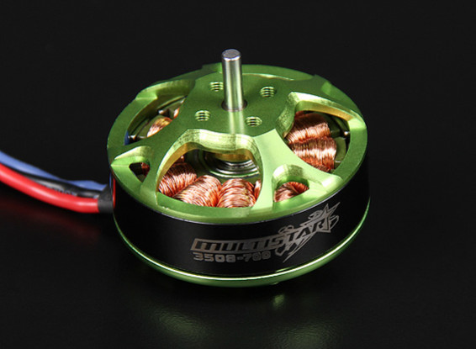
Simulation - Motor
Type:
MultiStar 700KV
BLDC
14.8 volt rating
0.134 Ohm
Goal:
Get relation between PWM and angular velocity
Notes:
KV 700 = 10360 RPM
Batt 14.8 volt (4s)
0.083 ohm in matlab (Probably wrong)

Slide 8
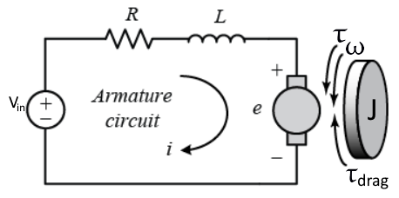
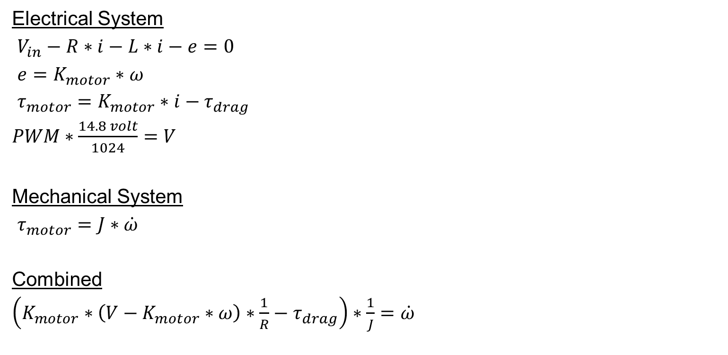
Simulation - Motor
Electrical System
$V_{in}−R∗i−L∗i−e=0$
$e=K_{motor}∗ω$
$τ_{motor}=K_{motor}∗i−τ_{drag}$
$PWM∗\frac{14.8 volt}{1024}=V$
Mechanical System
$τ_{motor}=J∗\dot{ω}$
Combined
$\left(K_{motor}∗\left(V−K_{motor}∗ω\right)∗\frac{1}{R}−τ_{drag}\right)∗\frac{1}{J}=\dot{ω}$
Notes:
Kirchofs law. Sum of all voltage in a closed loop is 0.
T_drag is the props giving resistance
Inductance is ignored
In analyzing the motor, we can usually ignore the inductance since the L/R electrical time constant is much shorter than the mechanical time constant determined by the rotor's moment of inertia

Slide 9
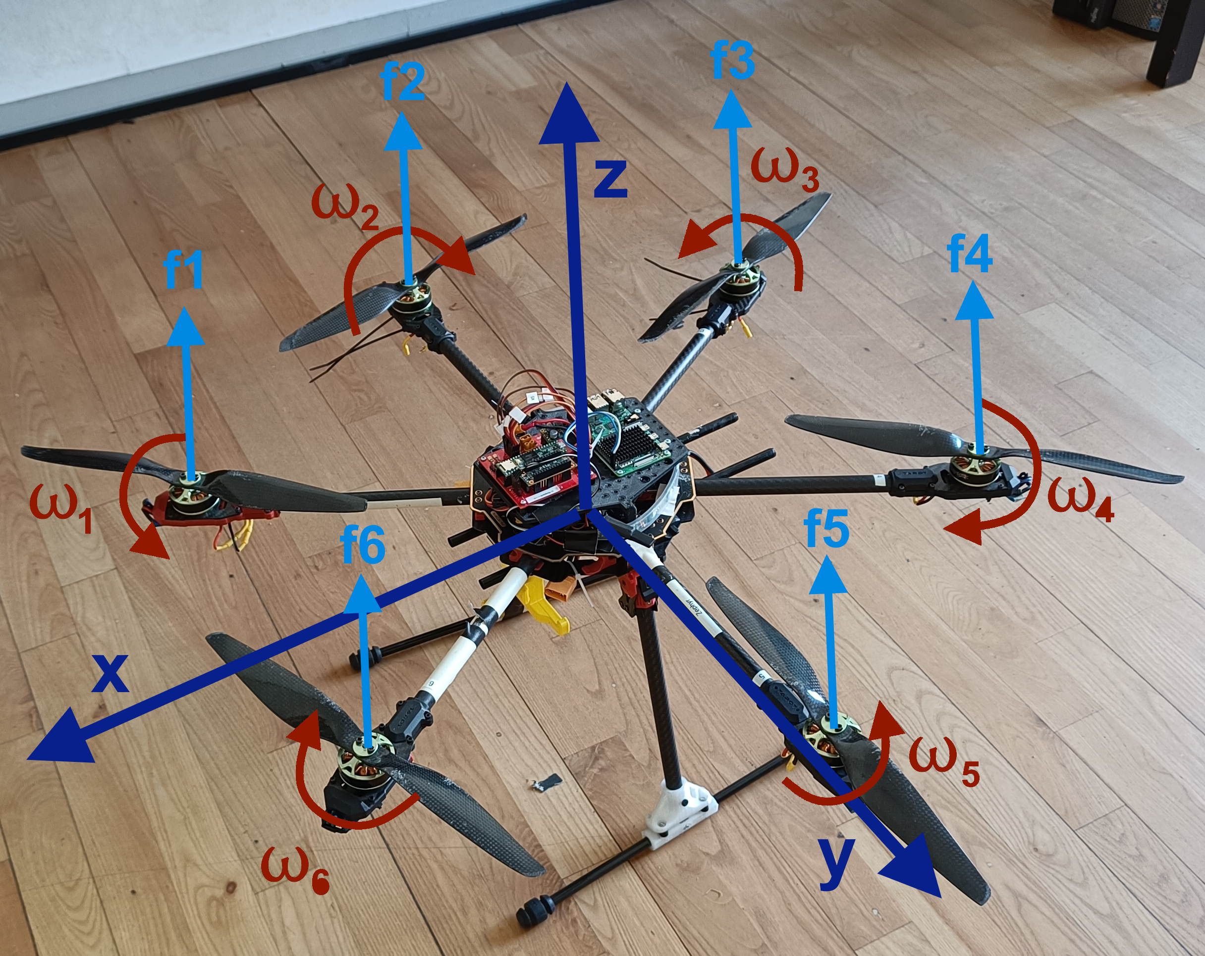
Simulation – Forces
Linear
Propeller force
Gravity
Air viscosity
Rotational
Motor torque
Thrust vector offset from center of mass
Notes:
Air viscosity. Only important for position control
Has 6 DOF, but can only apply a force in its own relative z direction

Slide 10
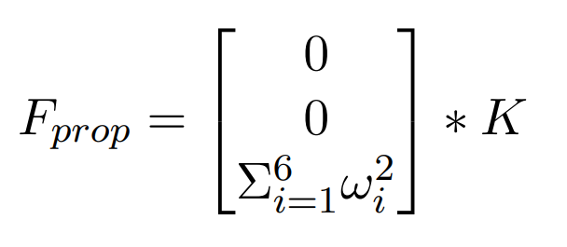
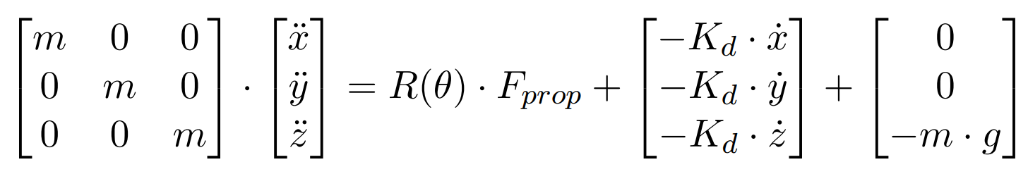
Simulation – Forces
Linear Dynamics
Notes:
Kd - Air viscosity. Only important for position control
K is constant describing relation between angular velocity and the lift generated

Slide 11
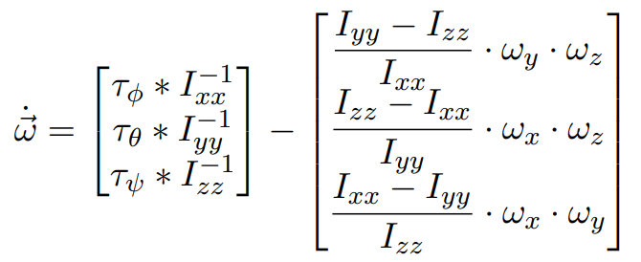
Simulation – Forces
Rotational Dynamics
Notes:
L_x and L_y describes point of lift.
B is drag coefficient for propellers
I_xx I_yy should be the same. I_zz is not
Drone can be decribed as a disc when talking inertia.
Final equation is angular acceleration around x y and z.
Last equation gives angular acceleration for x y and z.

Slide 12
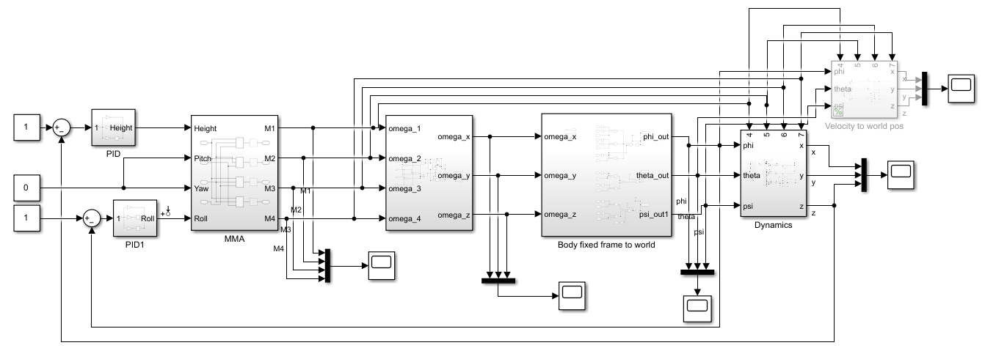
Simulation - Model

Slide 13
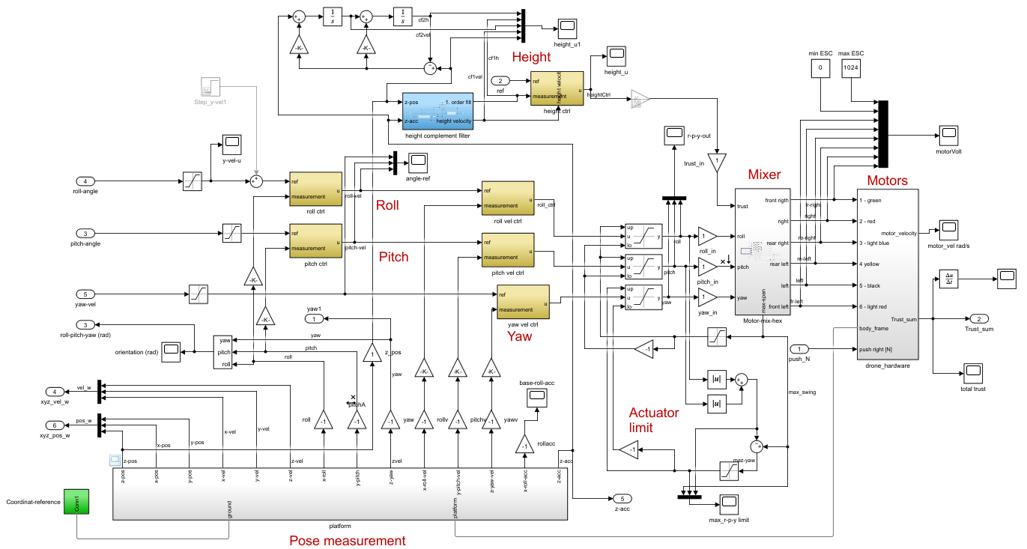
Simulation - Model

Slide 14
Controller Design

Slide 15
Controller Design - Type
PI-Lead
Simple design
Single Input Single Output
Linear Quadratic Regulator
Optimization approach
Difficult to tune afterwards
Multiple Input Multiple Output
Model Predictive Control
Comparable to LQR
Optimization approach
Generally considered more complex
Notes:
Requirements - Keep it simple
PID already used

Slide 16
Controller Design - Criterias
High Phase and Gain Margin
Stability against imperfect dynamics
Realistic Constant Gain
Avoid saturating actuator input
Avoid I Term
Windup problem
Avoid Fast Rise Time
Less agressive drone
Discretization
Billinear transform for controllers
Zero Order Hold for system
Notes:
High Phase and Gain Margin
Wrong value for ohm
Avoid I Term
Windup problem especially with height control
Avoid Fast Rise Time
Safer as well

Slide 17
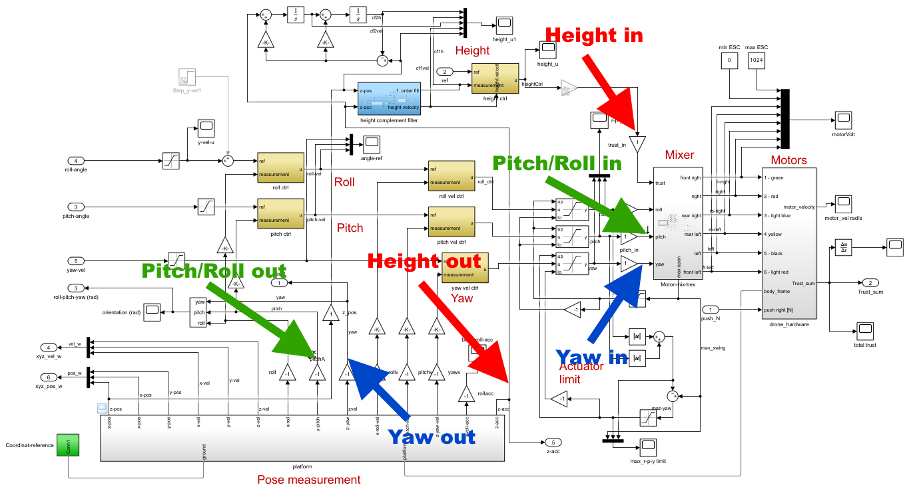
Controller Design - Linearization
Notes:
Slight mistake – Pitch/Roll out should be velocity. Same for yaw.

Slide 18
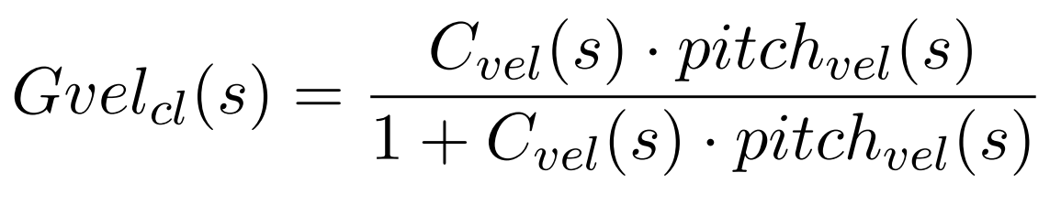
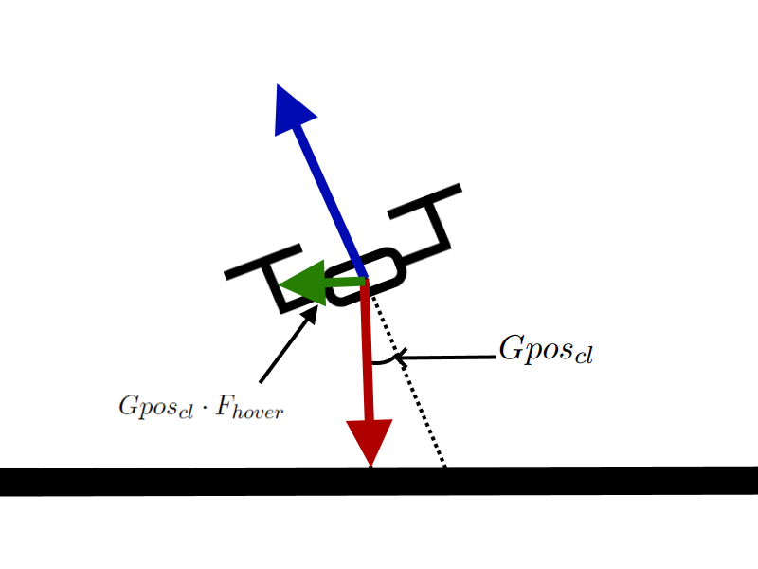
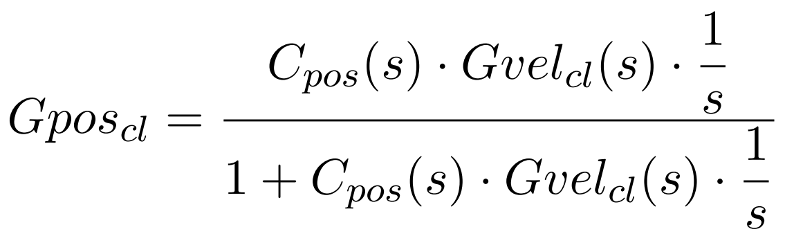
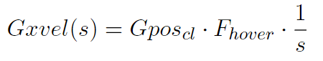
Controller Design – Pitch/Roll TF
Notes:
Gposcl output is radians
Step by step:
Apply pitch velocity controller to found TF and close loop
Integrate to get pitch position
Apply pitch position controller and close loop
Multiply with force required for hover. This gives the force applied based on the drones tilt
Integrate to get drone velocity

Slide 19
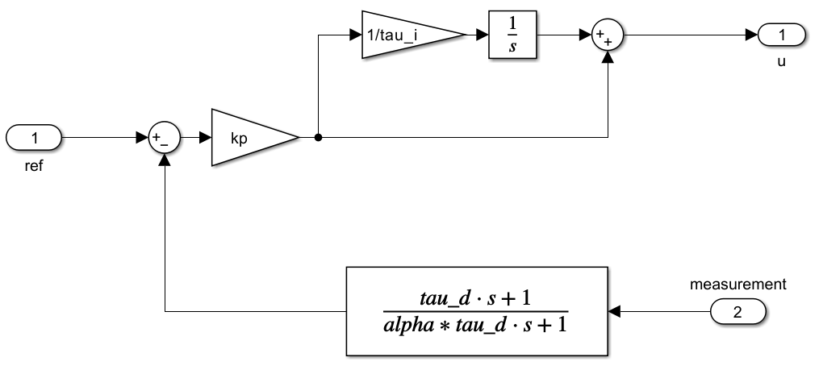
Controller Design
Notes:
Lead term i measurement. Fungere som filter på measurement samt er mere robust over for disturbance, på bekostning af rise time.
Største fordel er mindre overshoot.

Slide 20
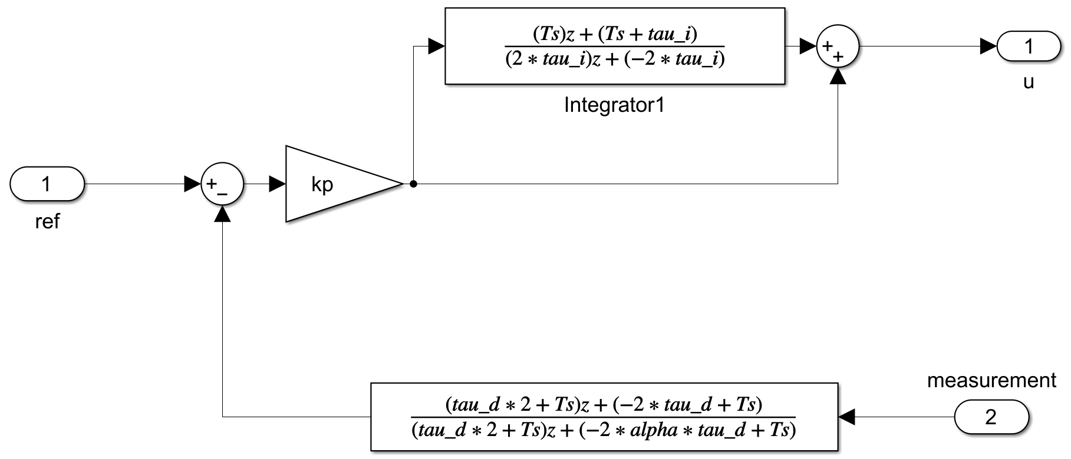
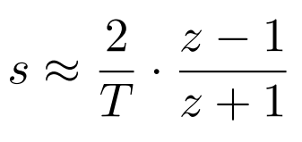
Controller Design
Notes:
Lead term i measurement. Fungere som filter på measurement samt er mere robust over for disturbance, på bekostning af rise time.
Største fordel er mindre overshoot.

Slide 21
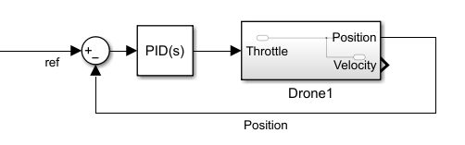
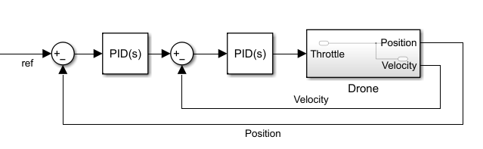
Controller Design – Height Control
PI-Lead design
Simple
Requires I term
Cascading P P-Lead design
Allows for velocity control
More complex

Slide 22
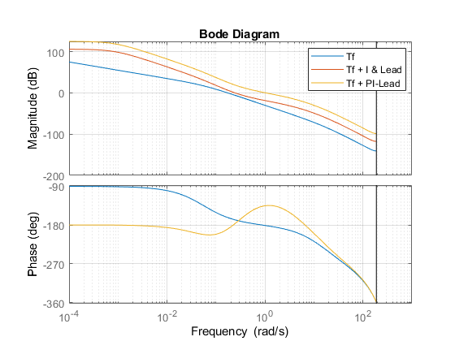
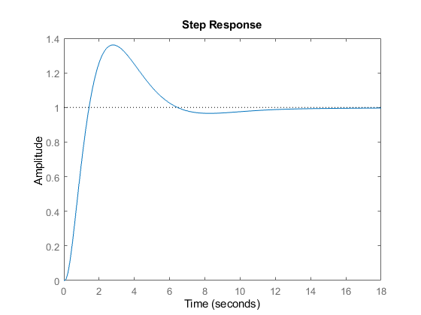
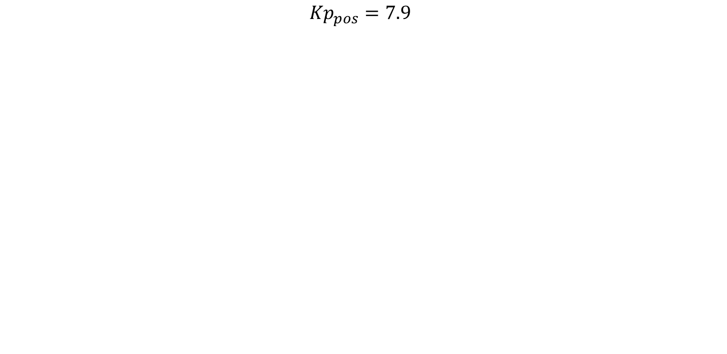
Controller Design – PI-Lead Height
$${Kp}_{pos}=7.9$$
Notes:
Actuator value is based on the error term and can therefore be very large if a large change in height is required.
Agressive lead factor of 0.07
Gain margin: 20 dB
Phase margin: 45 degrees

Slide 23
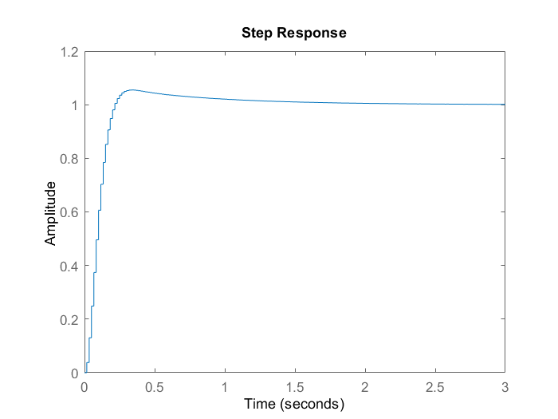
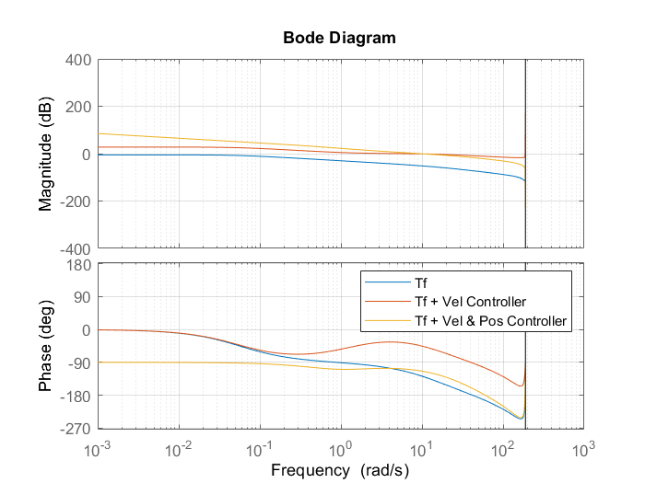
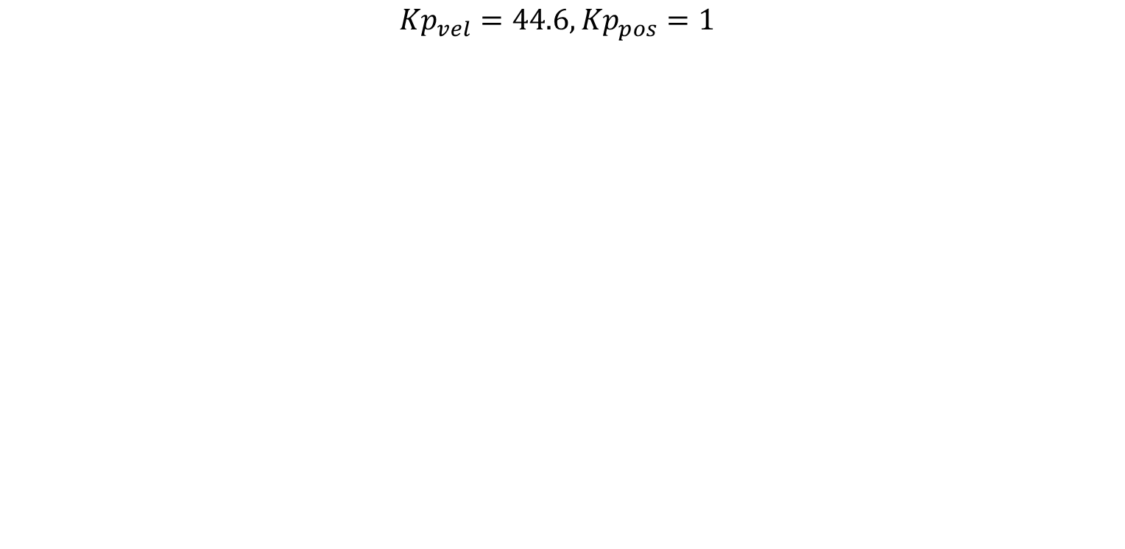
Controller Design – Cascading Height
$${Kp}_{vel}=44.6, {Kp}_{pos}=1$$
Notes:
Actuator input saturation is not an issue because pos controller max output is 1 to -1
Agressive lead factor of 0.07
Gain margin: 22 dB
Phase margin: 66 degrees

Slide 24
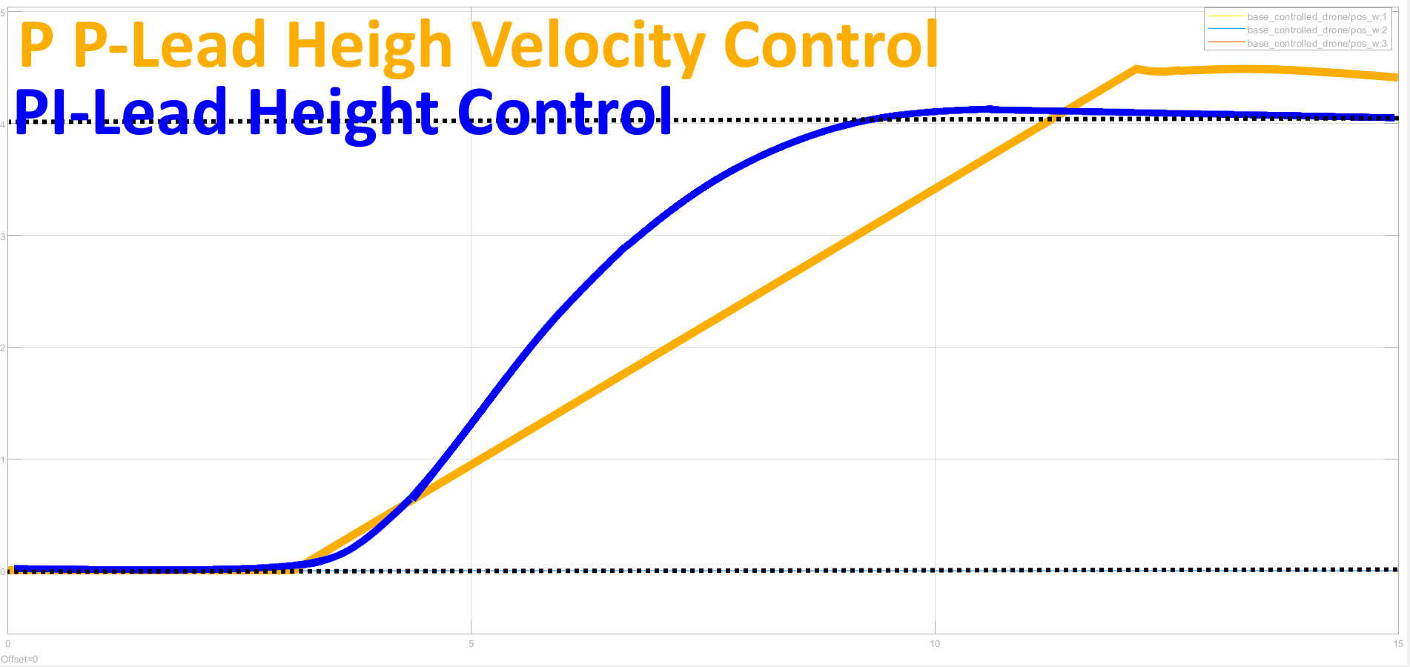
Controller Design – Height Simulation Evaluation
Test parameters
Reference height: 4 Meters
Prefered max velocity: 0.5 m/s
Cascading
Rise time: 8.1 seconds
Settle time: 16.5 seconds
Max velocity: 0.55 m/s
Max overshoot: 0.5 meter
PI-Lead
Rise time: 6.1 seconds
Settle time: 13.5 seconds
Max velocity: 1.05 m/s
Max overshoot: 0.13 meter
Notes:
Simulated controllers

Slide 25
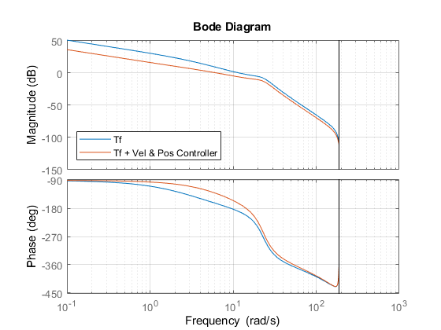
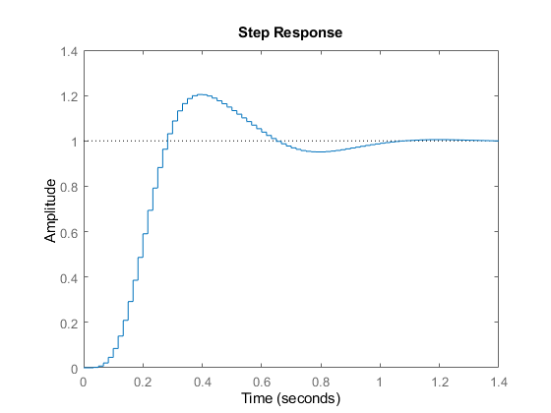
Controller Design – X/Y Control
Notes:
Cascading design
Less aggressive lead factor of 0.3

Slide 26
Controller Design – X/Y Control
Test parameters
Reference position: 4 meters along x-axis
Prefered max velocity: 1 m/s
Results
Rise time: 5.2 seconds
Settle time: 3 seconds
Max velocity: 1 m/s
Max overshoot: 3 cm
Steady state error: 3 cm

Slide 27
Implementation

Slide 28
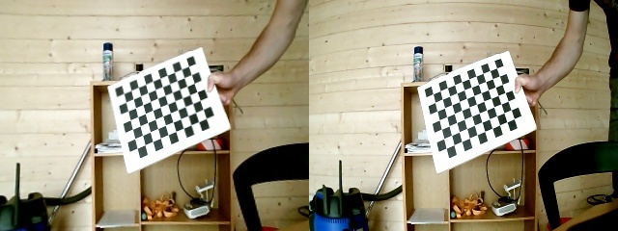
Implementation – Aruco Tracking
Aruco Tracking
Gives position and orientation of marker relative to drone.
Objectives
Get Intrinsic Camera Matrix
Allows for projecting a point in image plane to a line in 3d space
Align Drone Frame with Camera Frame
Aruco Transform
Notes:
Note that FOV is decreased

Slide 29
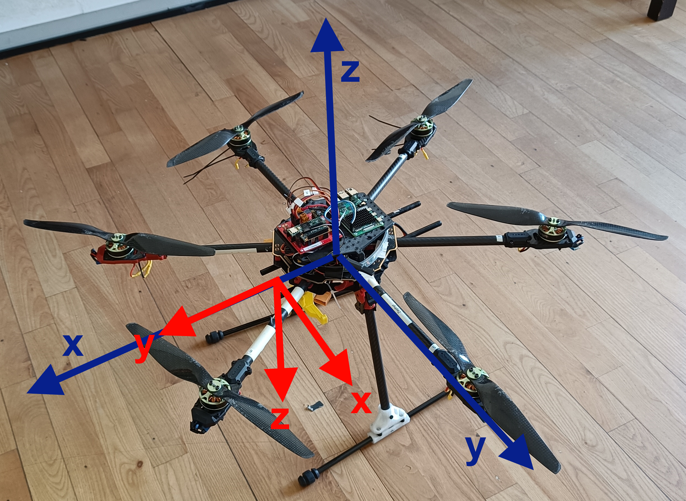
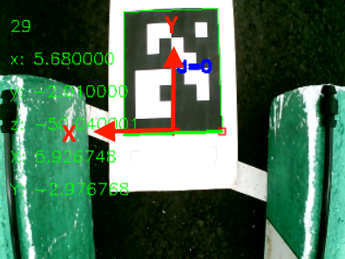
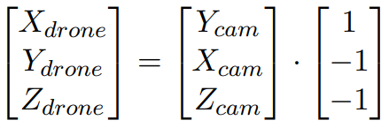
Implementation – Align Camera with Drone
Notes:
Point where camera is attached.
Take note that it aligns wit y=0 but not x=0.

Slide 30
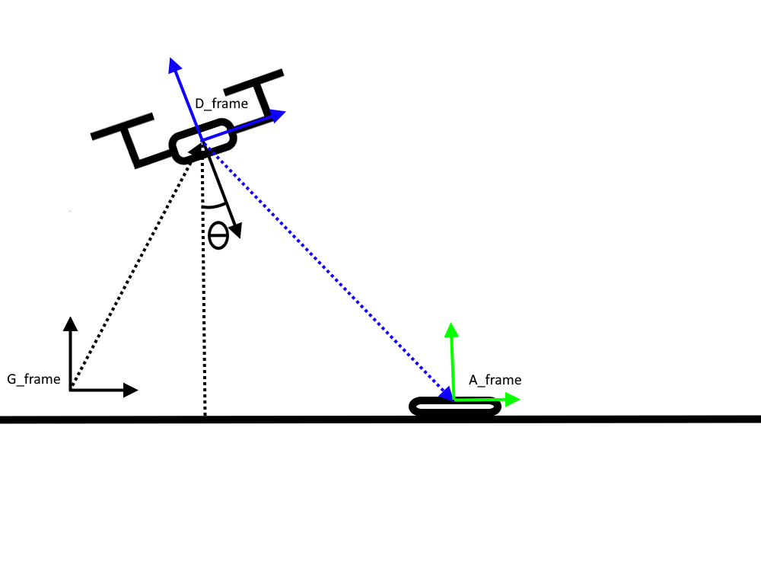
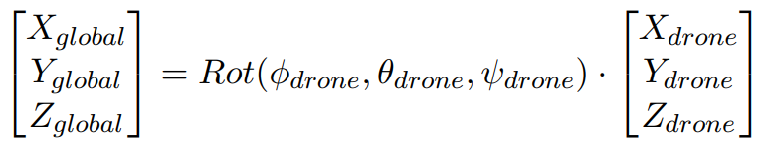
Implementation – Aruco Transform
Notes:
Misleading variable names
Orientation aligns with world. Position is relative to drone

Slide 31
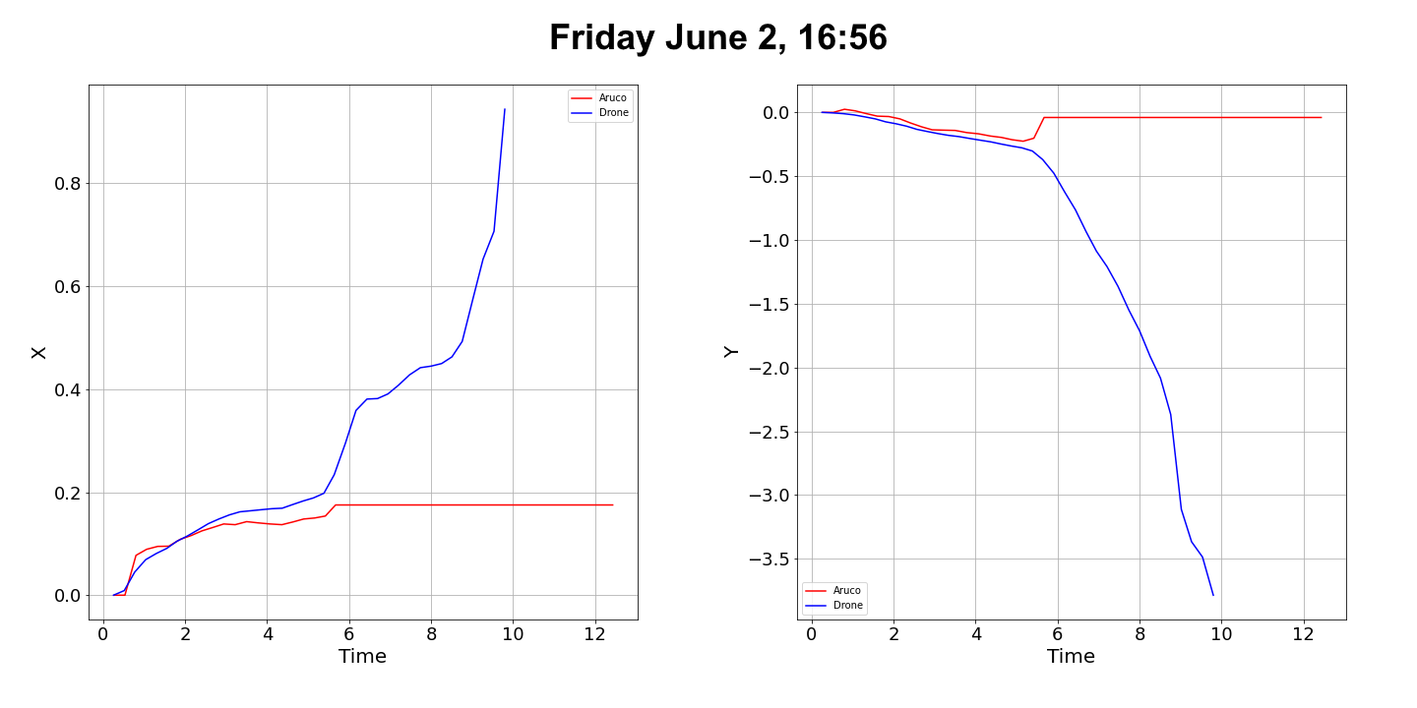
Implementation – Aruco Performance
Notes:
Blue is optitrack (Ground truth)
Loss of tracking
Camera not placed perfectly in the center of the drone
Low FOV
Low Resolution

Slide 32
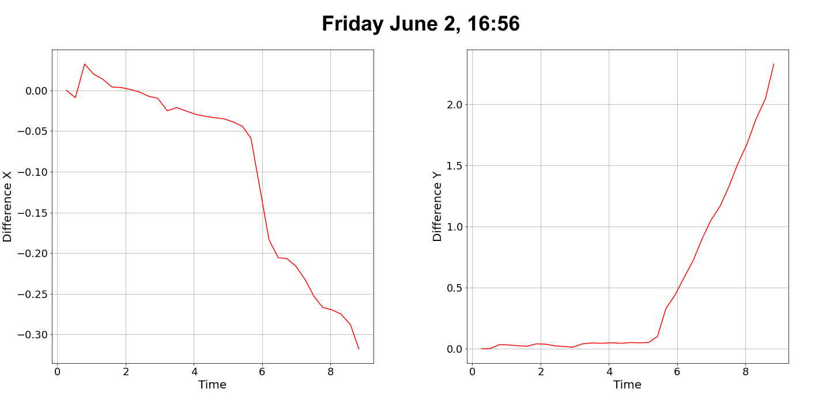
Implementation – Aruco Performance
Notes:
Clearly shows the alignment issue

Slide 33
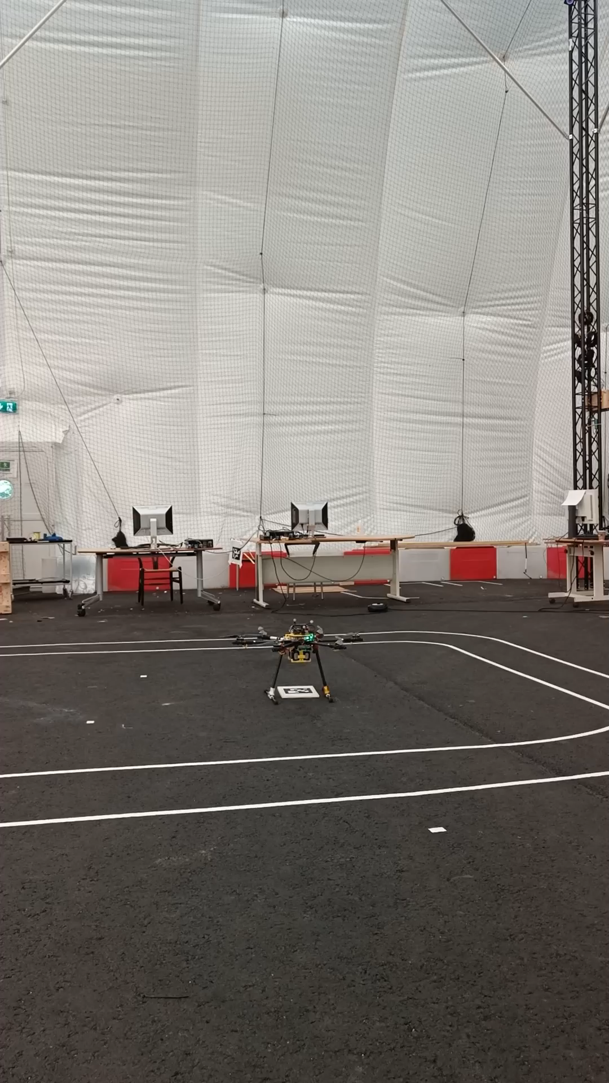

Slide 34
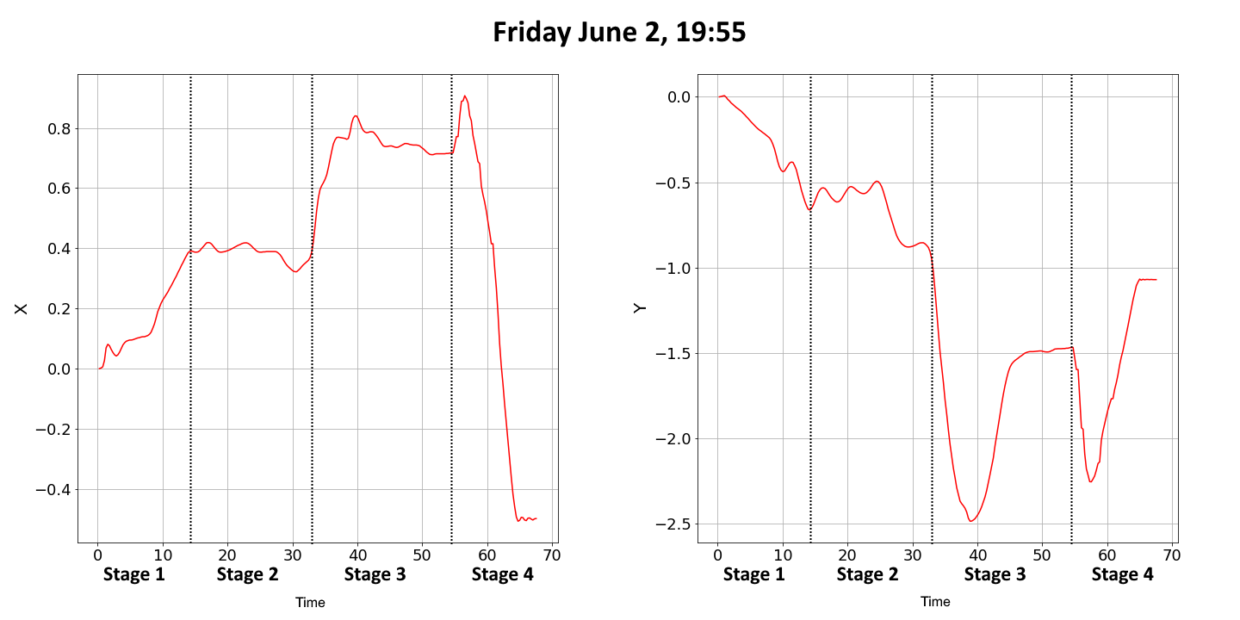
Implementation – Controller Performance
Position Controller Results
Rise time: 11~ seconds
Settle time: 3~ seconds
Max velocity: 0.68~ m/s
Max overshoot: 4~ cm
Steady state error: 5~ cm
Imperfect test case
Notes:
Stage 1 is where the drone has found an Aruco code and navigates toward it.
Stage 2 is where the drone is at the Aruco code.
Stage 3 is where the drone loses tracking and starts drifting until the Tracking Abort System kicks in (See Section 4.4) and the drone starts to hold its position.
Stage 4 is where the pilot takes manual control of the drone and lands it.

Slide 35
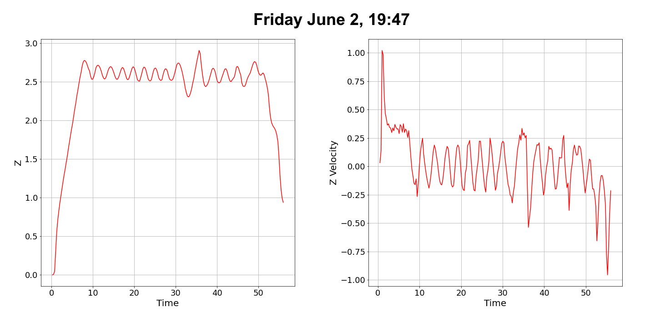
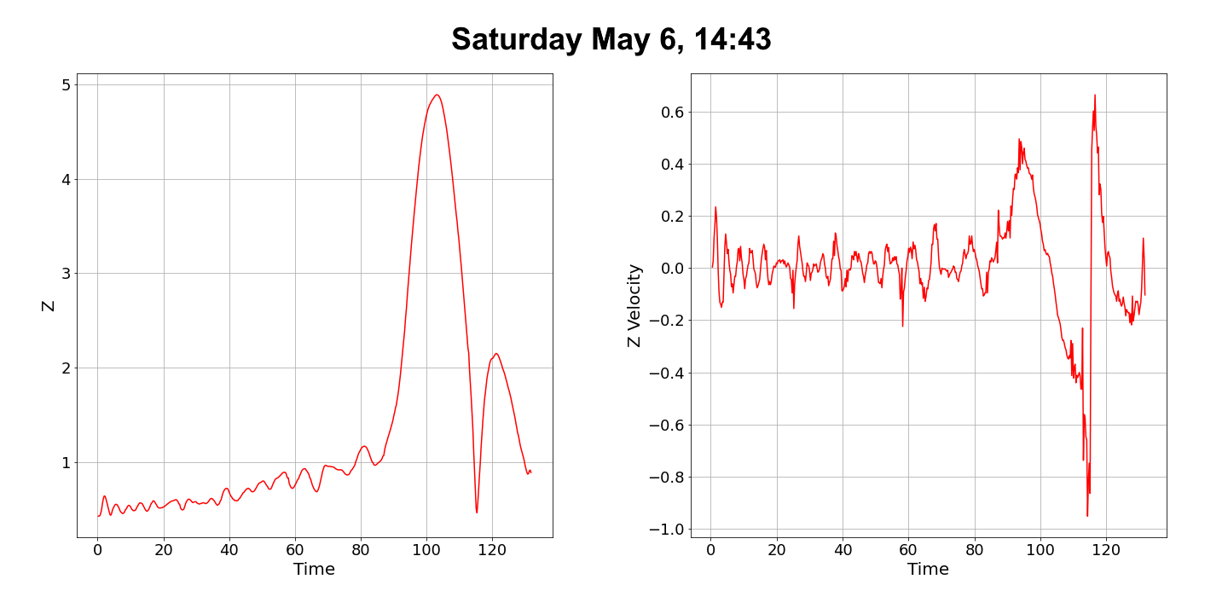
Implementation – Controller Performance
Cascading
Rise time: 8 seconds
Settle time: 3 seconds
Max velocity: 1 m/s
Steady state error: 0.6 meters
Oscillates
PI-Lead
Rise time: Misleading
Settle time: Unstable
Max velocity: 0.5 m/s
Steady state error: 1.3 meters

Slide 36
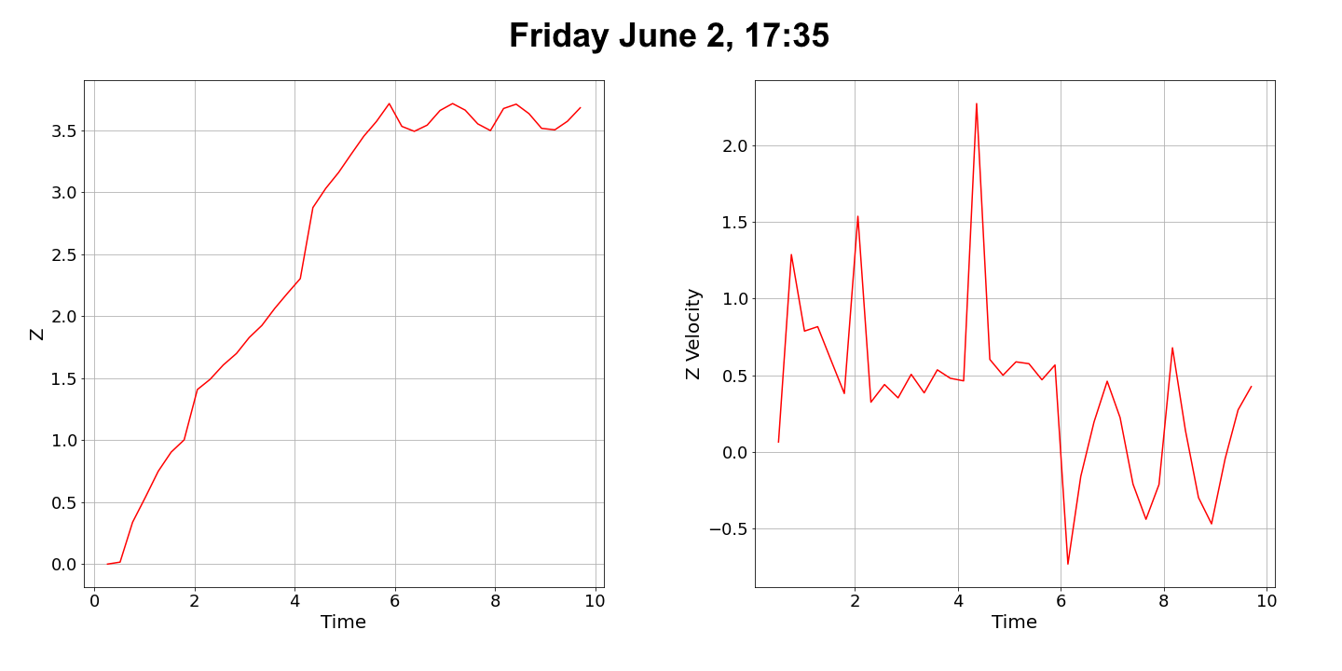
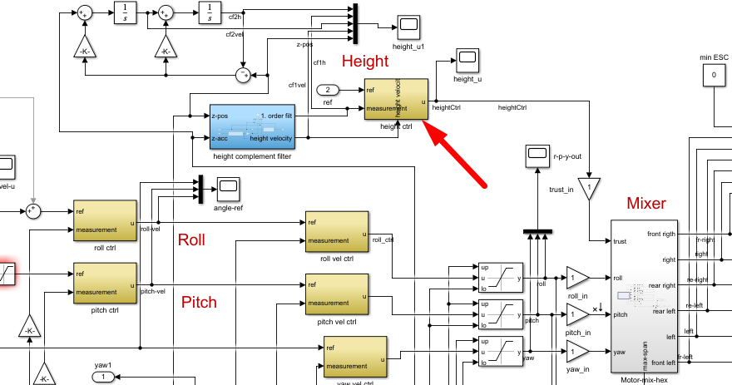
Implementation – Controller Performance
Issues encountered with height controller
Notes:
Left graph shows what happens if the position controller is allowed to go above 1 m/s
Why the PI-Lead didnt work
Couldnt disable height controller.

Slide 37
Conclusion

Slide 38
Conclusion
Simulate a Hexacopter in Simulink.
Use the simulation to design a positional controller for X, Y, Z, and Yaw.
Implement controllers on a real-time system.
Implement a global positioning System.
Implement an accurate positioning system for precision tasks.
Notes:
4: Simulated by using OptiTrack

Slide 39
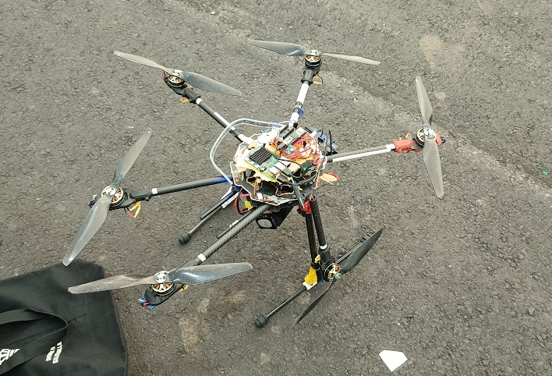
Future Works
Aruco Tracking
Better processor
Camera gimbal or 180 degree camera
Gyro Drift
Re-callibrate Madgwick filter
Safety Measures
Loss of motor recovery system
Human detection
Auto landing
Rigid frame
Test controllers again
PI-Lead height controller
Position controller
Notes:
Gyro drift: Linear acceleration seems to be acting too slow
Test controllers again: PI-Lead was never tested after fix. Position controller should be tested against

Slide 40
Questions?

